Slide 1
PHYS100 Computational Physics & Engineering Wednesday 01/23/2013

Slide 2
Computational physics & engineering is my term for what is now termed “computational science & engineering” or what was often called in past in numerical analysis
“Computational science and engineering (CSE) is a rapidly growing multidisciplinary area with connections to the sciences, engineering, mathematics, and computer science” (Petzold 2001).
Strang at MIT also uses the term CSE
“Computation is now regarded as an equal and indispensable partner, along with theory and experiment, in the advance of scientific knowledge and engineering practice.” ↔ Hence Trefethen’s statement on syllabus! (P 01)
“Numerical simulation enables the study of complex systems and natural phenomena that would be too expensive or dangerous, or even impossible, to study by direct experimentation.” (P 01)

Slide 3
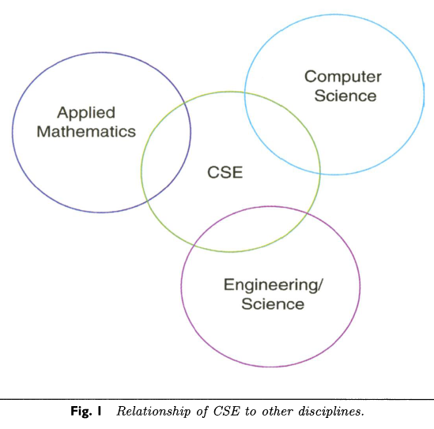
“CSE is a broad multidisciplinary area that encompasses application (science /engineering), applied mathematics, numerical analysis, and computer science and engineering (see Figure 1).” (P 01)

Slide 4
“Computer models and computer simulations have become an important part of the research repertoire, supplementing (and in some cases replacing) experimentation.” (P 01)
“It differs from mathematics or computer science in that analysis and methodologies are directed specifically at the solution of problem classes from science and engineering and will generally require a detailed knowledge or substantial collaboration from those disciplines. “ (P 01)
“It is more than a scientist or engineer using a canned code to generate and visualize results (skipping all of the intermediate steps). “ (P01)
Gilbert Strang (07) describing “the old method, separation of responsibilities, between math and engineering departments, no longer works” -
“Mathematics courses teach analytic techniques.”
“Engineering courses work on real problems. “

Slide 5
Petzold (2001) as well as a critique of mathematics versus computing by a giant in the field, George Forsythe, from 1969 is included in notes
What I want to focus on now is fundamental differences between computation and symbolic computing (e.g. Mathematica & Maple)
Symbolic computation also termed computer algebra
manipulates mathematical expressions (Manipulates formulas exactly)
similar to manipulations you learned in calculus
Mathematica 8.0:
In(1) = Integrate[Cos[x], x]
Out(1)= Sin[x]
In(2) = Solve[ a*x^2 + b*x + c == 0, x]

Slide 6
Note what happens with quartic polynomial:
Clear[x, a, b, c, d, e]
Solve[a*x^4 + b*x^3 + c*x^2 + d*x + e == 0, x]
Replace coefficents by numbers:
Solve[ x^4 + 2*x^3 + 5*x^2 + 3*x + 7 == 0, x]
To get actual numbers you must evaluate expression
N[%] (* OR *)
NSolve[ x^4 + 2*x^3 + 5*x^2 + 3*x + 7 == 0, x]
Note what different happens with quartic polynomial:
Clear[x, a, b, c, d, e, f]
Solve[a*x^5 + b*x^4 + c*x^3 + d*x^2 + e*x + f == 0, x]

Slide 7
FUNDAMENTAL ISSUES :
Many/ Most problems of technical interest cannot be solved symbolically
When they can, symbolic expressions tend to grow exponentially!

Slide 8
Concrete example – consider following (seemingly straightforward) one-dimensional integrations -
>
> g = @(x) sin(sin(x)); % examine in MATLAB
>> h = @(x) x.^x; % MATLAB commands
>> n_points = 2500;
>> fplot(g, [0, 1], n_points); % MATLAB commands
>> hold on;
>> fplot(h, [0, 1], n_points);
Will attempt to integrate symbolically in Mathematica once plotted

Slide 9
Plot shows these functions continuous 0 ≤ x ≤ 1

Slide 10
Now integrate in Mathematica
In(17) = Integrate[x^x, x]
In(18) = Integrate[Sin[Sin[x]], x]
Try computationally:
In(19) = NIntegrate[x^x, {x, 0, 1}]
Out(19) = 0.783431

Slide 11
In(20) = NIntegrate[Sin[Sin[x]], {x, 0, 1}]
Out(20) = 0.430606

Slide 12
If you are sure of an answer calculate with a different algorithm as a check!
>> % Integrate these functions numerically in MATLAB
>> quadgk(g, 0.0, 1.0) % SAME values as Mathematica
ans = 0.430606103120691
>> quadgk(h, 0.0, 1.0)
ans = 0.783430510712433
% Now look at function which can be integrated symbolically
> f = @(x) exp(-x) .*cos(6.0*x).^5 .*sin(5.0*x).^6;
>> fplot(f, [-1, 1], n_points); % Look at next page
>> quadgk(f, -1.0, 1.0)
ans = 0.087147365543234
Mathematica -
Integrate[ Exp[-x]* Cos[6*x]^5 * Sin[5*x]^6, x]
NIntegrate[ Exp[-x]* Cos[6*x]^5 * Sin[5*x]^6, {x], -1, 1}]
0.0871474

Slide 14
Previous concrete examples illustrate why computational algorithms are employed
Instead of symbolic algorithms we employ computational algorithms
“Central mission of numerical analysis is to compute quantities that are typically uncomputable from an analytic point of view, and do it with lightning speed” (Trefethen 1992).

